Slide 1

title
TEAM MEMBERS:
VISHAL.S
GOVARDHINE.K
PRAVEEN.R
SAI RAVI GANESH.V

Slide 2
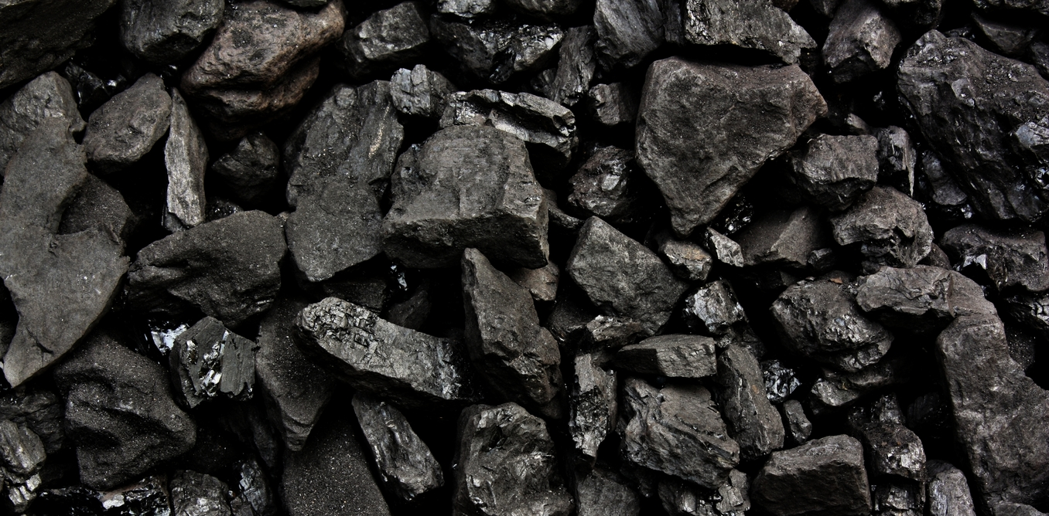
WHAT IS COAL ?
Coal is a sedimentary deposit composed predominantly of carbon that is readily combustible. Coal is black or brownish-black, and has a composition that (including inherent moisture) consists of more than 50 percent by weight and more than 70 percent by volume of carbonaceous material. It is formed from plant remains that have been compacted, hardened, chemically altered, and metamorphosed by heat and pressure over geologic time . Coal is found all over the world. It is composed mostly of carbon and hydrocarbons, which contain energy that can be released through combustion (burning).

Slide 3

Coal has its own advantages and disadvantages as enlisted below:
ADVANTAGES:
Coal is cheaper than other fossil fuels.
Coal is easy to store compared to other fuels.
Coal is a safe alternative fuel.
Minimal amount of waste is produced.
Coal is known for being a highly compatible source of fuel. It provides us the leverage to collaborate with other energy sources to bring real-time advantages for people
DISADVANTAGES:
Even though,Coal is currently in abundance, it is a nonrenewable energy source.
Coal is harmful to health.
Mining/Burning of coal causes Noise pollution as well as Air pollution.
Coal can generate higher levels of carbon emission than other energy sources.
Coal is actually radioactive.

Slide 4
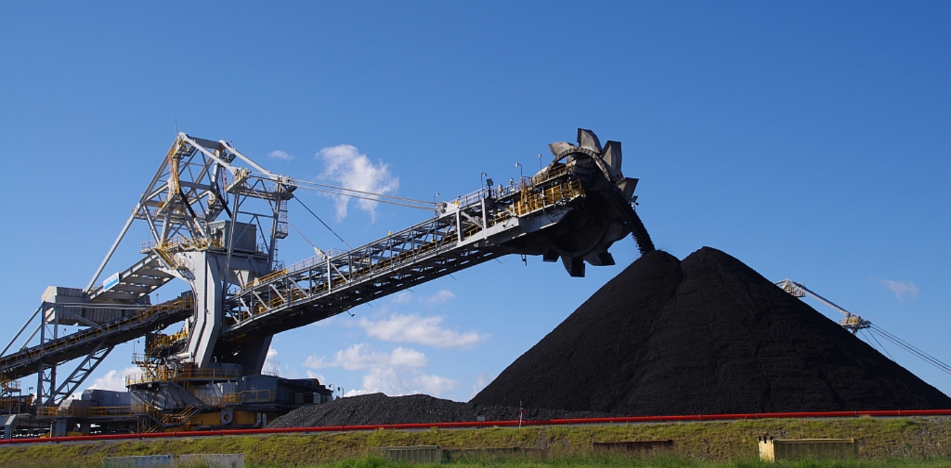
COAL MINING:
Coal mining is the process of extracting coal from the ground. Coal is valued for its energy content and since the 1880s has been widely used to generate electricity. Steel and cement industries use coal as a fuel for extraction of iron from iron ore and for cement production.
IMPORTANCE OF COAL MINING:
As the National Mining Association reports, the coal industry is a vital source of jobs that create positive ripple effects throughout society and our economy. These include the direct employment of nearly 150,000 people and the creation of 3.3 jobs for every job in coal mining, for a total of more than 500,000 jobs.

Slide 5

COAL MINING’S HARMFUL FEFFECTS
Coal mining causes acid mine drainage, which causes heavy metals to dissolve and seep into ground and surface water. Coal mine workers also sometimes face serious health problems, including lung disease from prolonged exposure to coal dust in mines.
The main toxic gases in mines are carbon monoxide (CO) and carbon dioxide (CO₂); the flammable gases are methane (CH₄), CO, and hydrogen (H₂); the suffocating gases are CO₂, nitrogen (N₂0), and CH₄; and the toxic gases are CO, nitrogen oxides (NOx), and hydrogen sulphide(H ₂S).
Coal workers' pneumoconiosis (CWP), commonly known as "black lung disease," occurs when coal dust is inhaled. Over time, continued exposure to the coal dust causes scarring in the lungs, impairing your ability to breathe. Considered an occupational lung disease, it is most common among coal miners.
Coal dust is one of the main reason due to which workers are affected by the black lung disease and suffer from breathing problems.

Slide 6
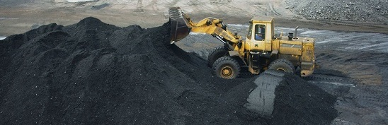
COAL DUST
Coal dust is a fine powdered form of which is created by the crushing, grinding, or pulverizing of coal. Because of the brittle nature of coal, coal dust can be created during mining, transportation, or by mechanically handling coal. It is a form of fugitive dust.
In general, the most common clay minerals found in coal are kaolinite and illite. With regard to the other constituents, calcite and siderite are common carbonates, and pyrite a common sulfite.
The term “mine size coal” was adopted in about 1925 and refers to coal dust, all of which passes a U.S. Standard No. 20 sieve (850 µm) and contains 20% minus 200-mesh (75 µm).

Slide 7
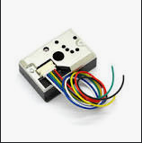
SENSORS USED TO DETECT DUST:
DUST SENSOR:
Description: Dust Sensor is a simple air monitoring module with onboard Sharp GP2Y1010AU0F. It is capable of detecting fine icle larger than 0.8μm in diameter, even like the cigarette smoke. Analog voltage output of the sensor is linear with dust density.
Sensor Pin: MCU Pin

Slide 8
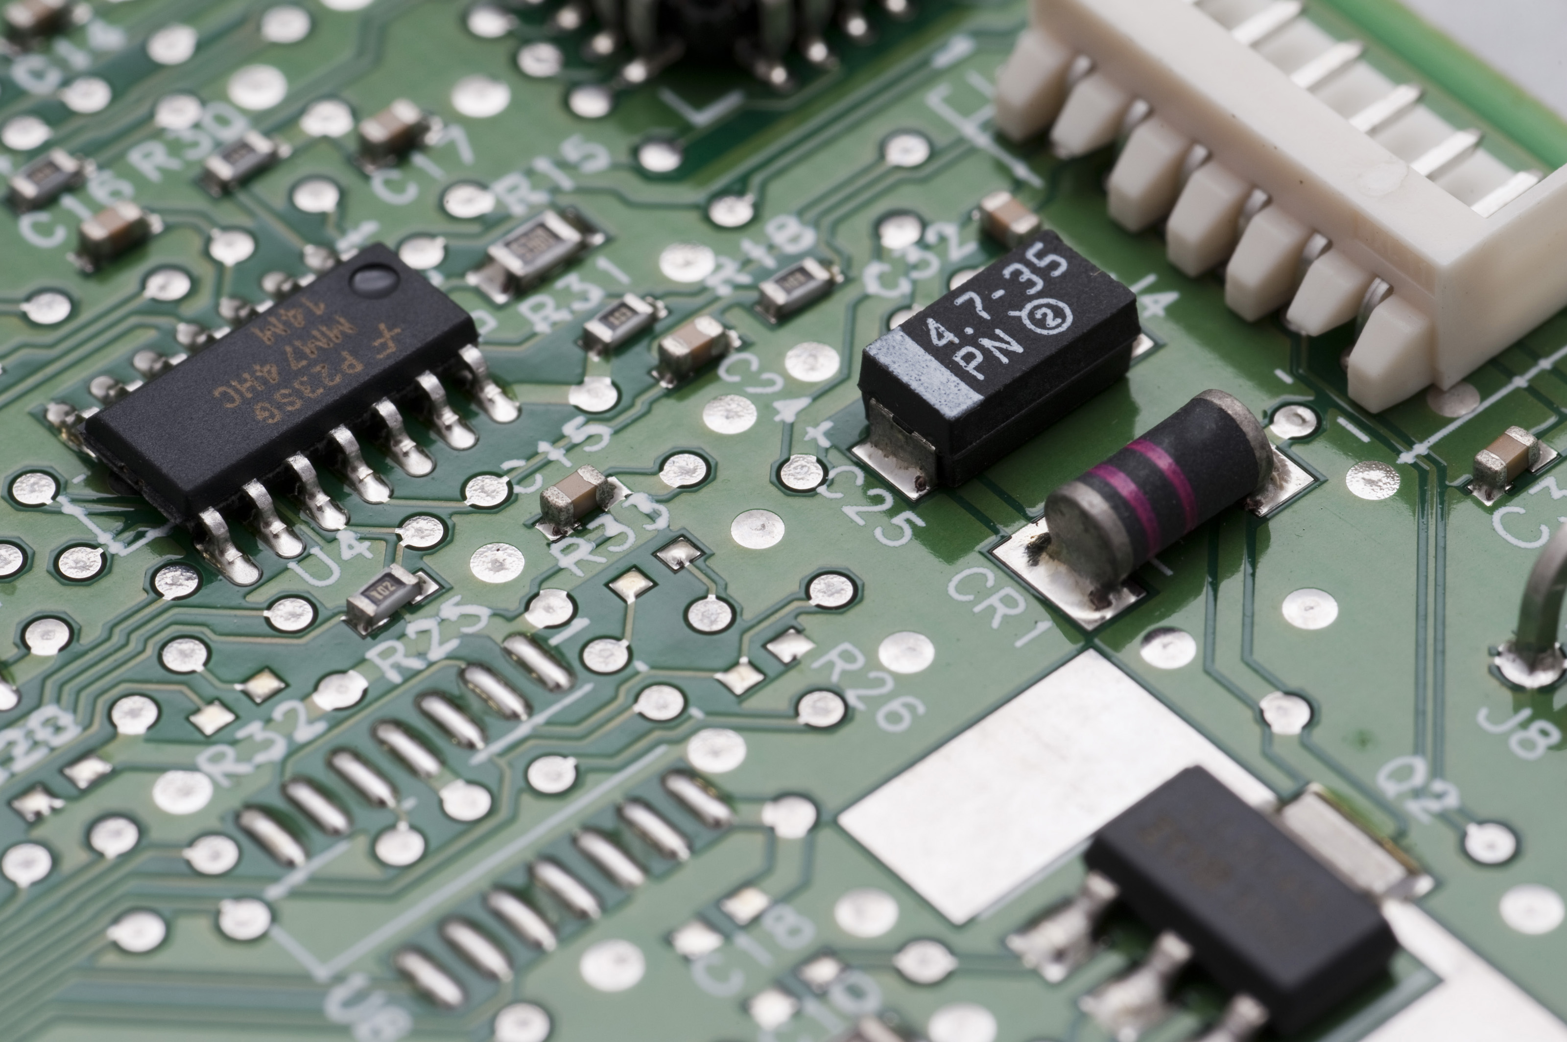
COMPONENTS REQUIRED TO MAKE THE SENSOR DEVICE:
ARDUINO
BREAD BOARD
JUMPER WIRES
SOLDERING KIT
GAS SENSOR
MQ SENSOR

